Slide 1
PART 7
Ordinary Differential Equations ODEs

Slide 2
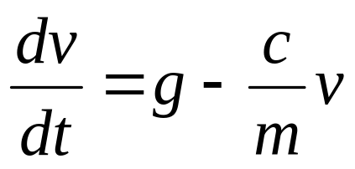
Ordinary Differential Equations
Part 7
Equations which are composed of an unknown function and its derivatives are called differential equations.
Differential equations play a fundamental role in engineering because many physical phenomena are best formulated mathematically in terms of their rate of change.
v - dependent variable
t - independent variable

Slide 3
Ordinary Differential Equations
When a function involves one dependent variable, the equation is called an ordinary differential equation (ODE).
A partial differential equation (PDE) involves two or more independent variables.

Slide 4
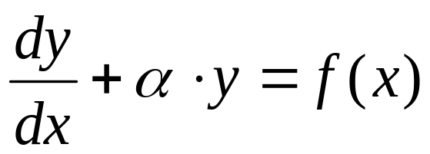
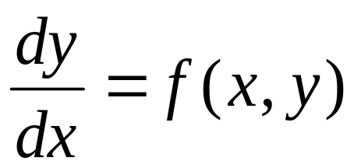
Ordinary Differential Equations
Differential equations are also classified as to their order:
A first order equation includes a first derivative as its highest derivative.
  - Linear 1st order ODE
  - Non-Linear 1st order ODE
  Where f(x,y) is nonlinear

Slide 5
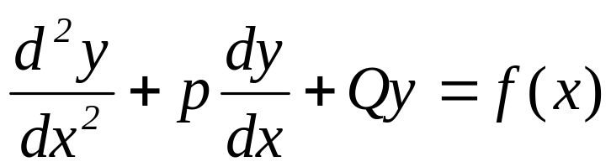
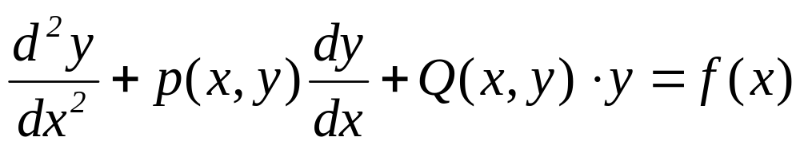
Ordinary Differential Equations
  A second order equation includes a second derivative.
- Linear 2nd order ODE
- Non-Linear 2nd order ODE
Higher order equations can be reduced to a system of first order equations, by redefining a variable.

Slide 6
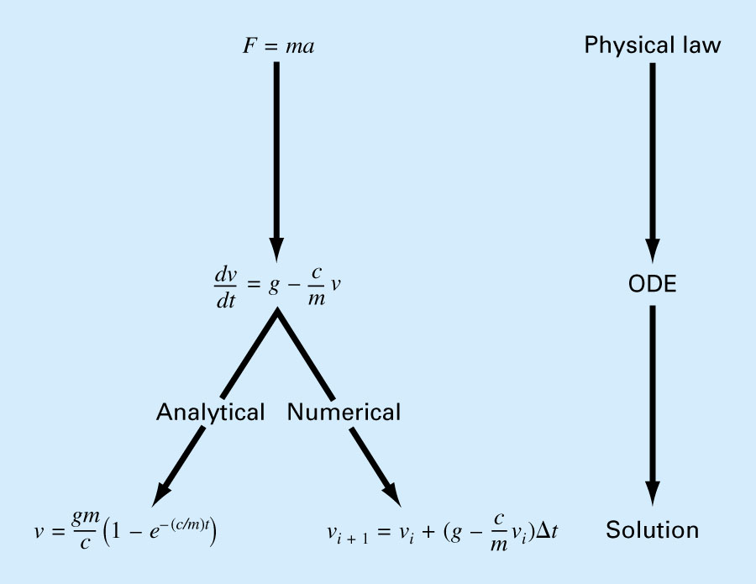
Ordinary Differential Equations

Slide 7
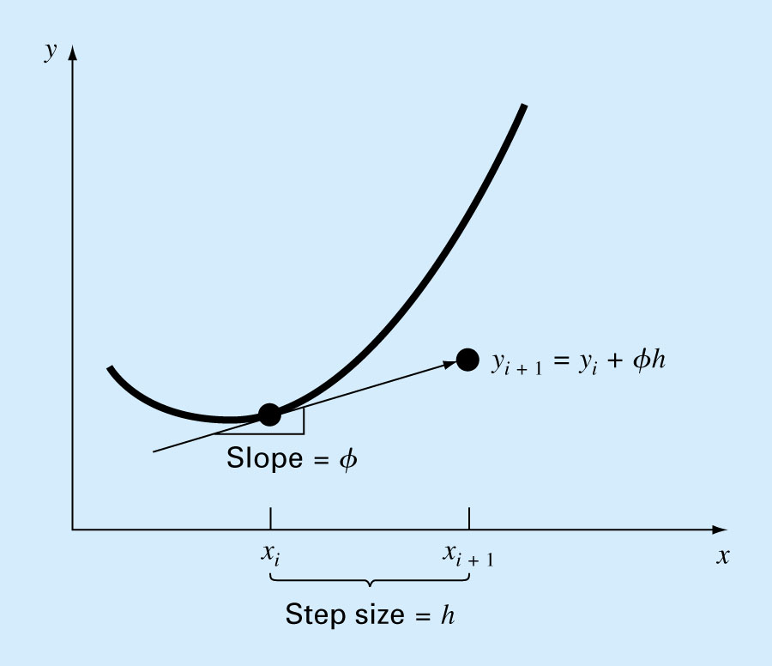


Runge-Kutta Methods
This chapter is devoted to solving ODE of the form:
Euler’s Method
solution

Slide 8
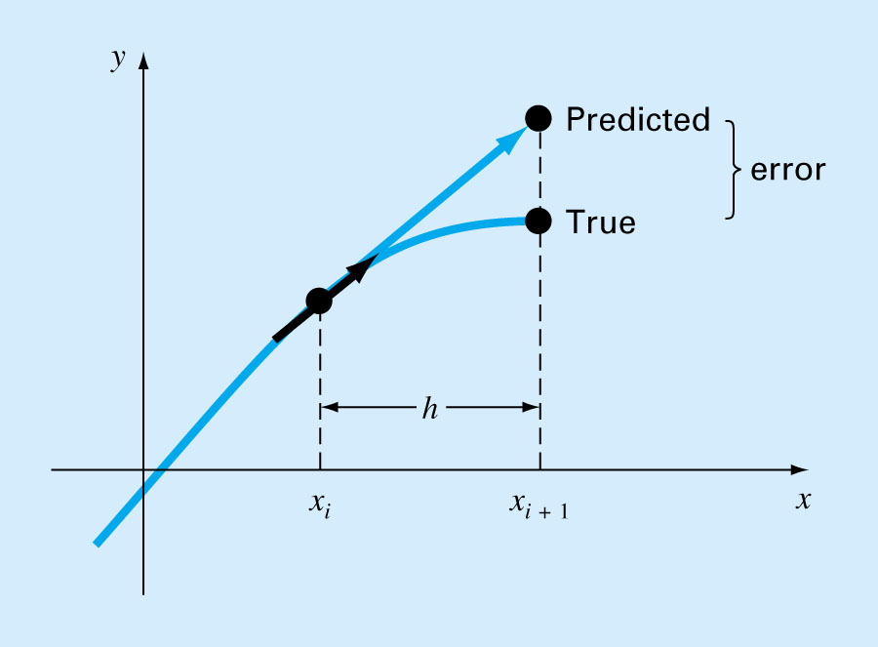
Runge-Kutta Methods

Slide 9
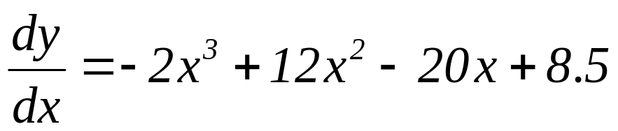
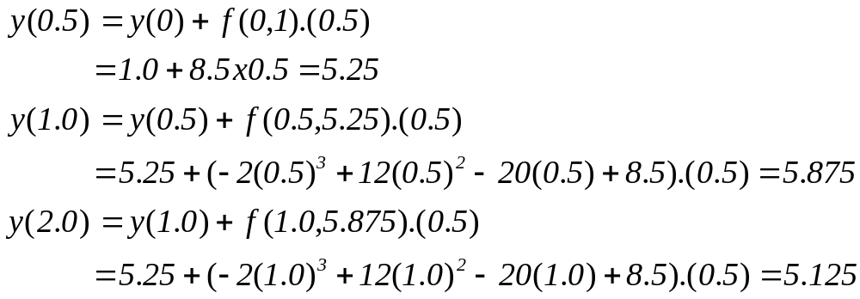
Euler’s Method: Example
Obtain a solution between x = 0 to x = 4
with a step size of 0.5 for:
Initial conditions are: x = 0 to y = 1
Solution:

Slide 10
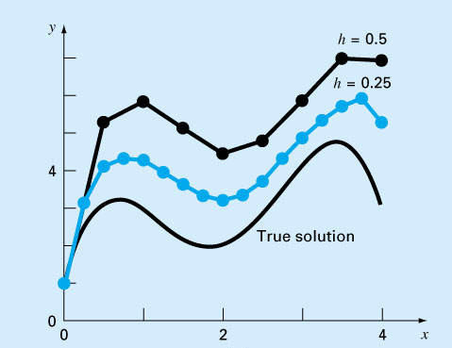
Euler’s Method: Example
Although the computation captures the general trend solution, the error is considerable.
This error can be reduced by using a smaller step size.

Slide 11
Improvements of Euler’s method
A fundamental source of error in Euler’s method is that the derivative at the beginning of the interval is assumed to apply across the entire interval.
Simple modifications are available:
  Heun’s Method
  The Midpoint Method
  Ralston’s Method

Slide 12
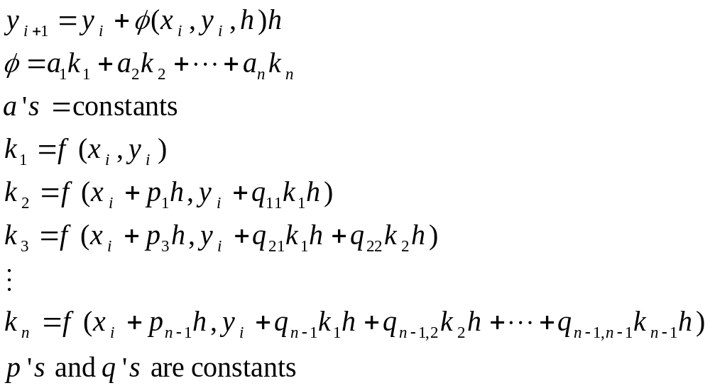
Runge-Kutta Methods
Runge-Kutta methods achieve the accuracy of a Taylor series approach without requiring the calculation of higher derivatives.
Increment function (representative slope over the interval)

Slide 13
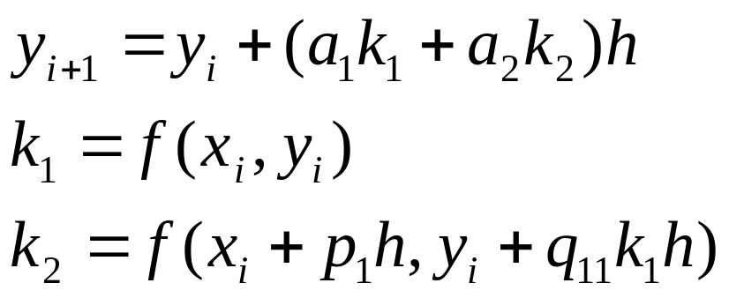
Runge-Kutta Methods
Various types of RK methods can be devised by employing different number of terms in the increment function as specified by n.
First order RK method with n=1 is Euler’s method.
  Error is proportional to O(h)
Second order RK methods:
  - Error is proportional to O(h²)
Values of a₁, a₂, p₁, and q₁₁ are evaluated by setting the second order equation to Taylor series expansion to the second order term.

Slide 14
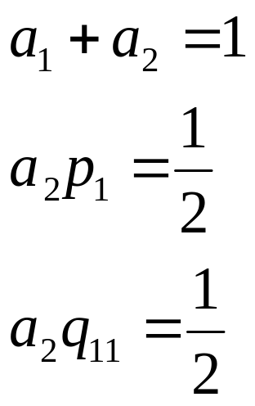
Runge-Kutta Methods
Three equations to evaluate the four unknown constants are derived:
A value is assumed for one of the unknowns to solve for the other three.

Slide 15
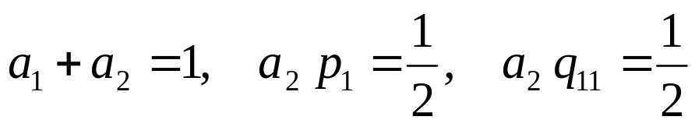
Runge-Kutta Methods
We can choose an infinite number of values for a₂,there are an infinite number of second-order RK methods.
Every version would yield exactly the same results if the solution to ODE were quadratic, linear, or a constant.
However, they yield different results if the solution is more complicated (typically the case).

Slide 16
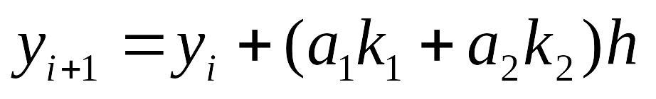






Runge-Kutta Methods
Three of the most commonly used methods are:
Huen Method with a Single Corrector (a₂=1/2)
The Midpoint Method (a₂= 1)
Raltson’s Method (a₂= 2/3)

Slide 17


Runge-Kutta Methods
y
Heun’s Method:
Involves the determination of two derivatives for the interval at the initial point and the end point.
f(x_{i}+h,y_{i}+k₁h)
f(x_{i},y_{i})
x
x_{i}
x_{i}+h
y
ε_{a}
Slope: 0.5(k₁+k₂)
x
x_{i}
x_{i}+h

Slide 18

Runge-Kutta Methods
y
Midpoint Method:
Uses Euler’s method to predict a value of y at the midpoint of the interval:
f(x_{i}+h/2,y_{i}+k₁h/2)
f(x_{i},y_{i})
x
x_{i}
x_{i}+h/2
y
ε_{a}
Slope: k₂
x
Chapter 25
x_{i}
x_{i}+h

Slide 19

Runge-Kutta Methods
y
Ralston’s Method:
f(x_{i}+ 3/4 h, y_{i}+3/4k₁h)
f(x_{i},y_{i})
x_{i}
x_{i}+3/4h
x
y
ε_{a}
Slope: (1/3k₁+2/3k₂)
x_{i}
x_{i}+h
x
Chapter 25

Slide 20
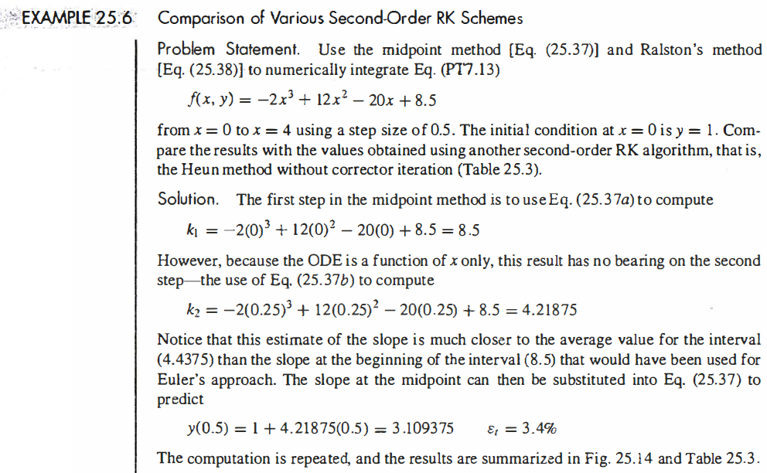

Slide 21
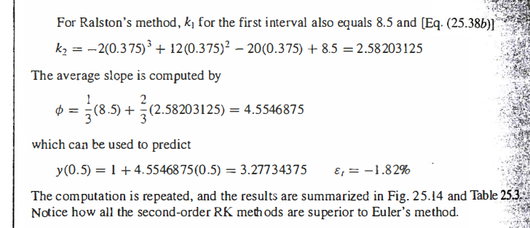
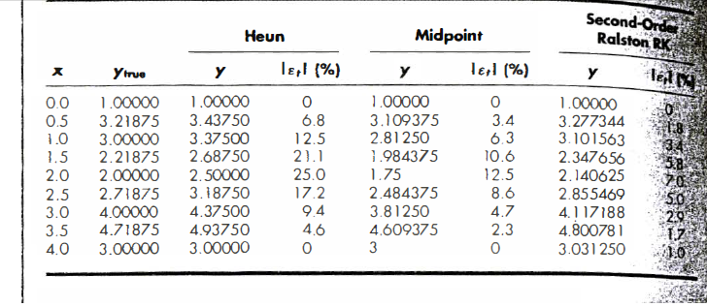

Slide 22
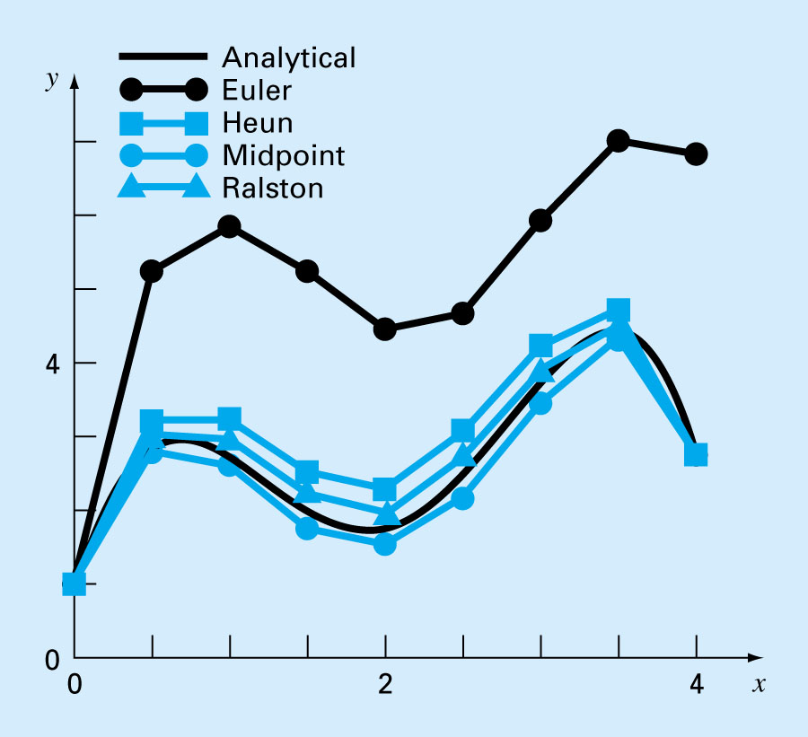
Chapter 25

Slide 23
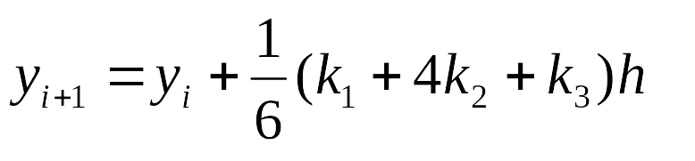
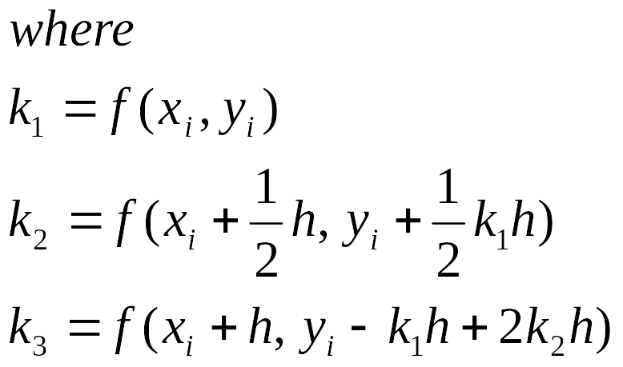
Runge-Kutta Methods
Third order RK methods
Chapter 25

Slide 24
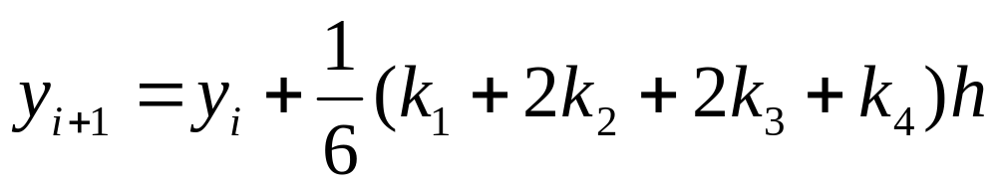
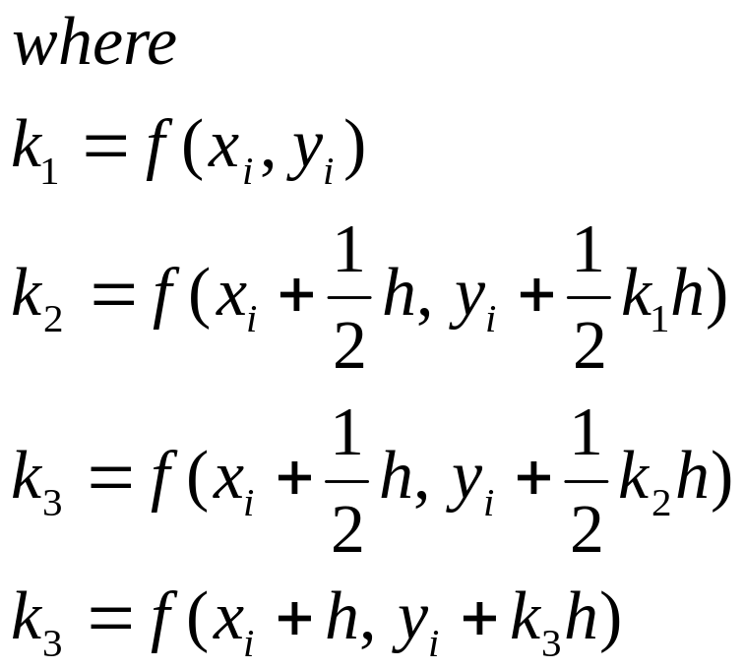
Runge-Kutta Methods
Fourth order RK methods
Chapter 25

Slide 25
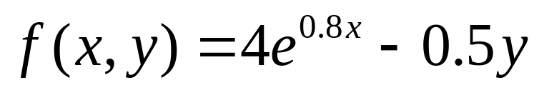
Comparison of Runge-Kutta Methods
Use first to fourth order RK methods to solve the equation from x = 0 to x = 4
Initial condition y(0) = 2, exact answer of y(4) = 75.33896
Chapter 25

